Slide 1
Power System Planning
Prof. Dr. Muhammad Kamran
Lecture No. 5
mkamran@uet.edu.pk

Slide 2
Contents
Maximum diversified Demand
Load Forecasting
Box-Jenkins Method
Small Area Load Forecasting
Spatial Load Forecasting
Problems

Slide 3
Maximum Diversified Load
Scientists developed a method of estimating Transformer load in residential areas by diversified demand method which takes into account the diversity between similar loads and non coincidence of peaks of different types of loads
It is the ratio of the demand of particular type of load coincident with the group maximum demand to maximum demand of that particular load

Slide 4
Coincident demand: The energy demand required by a given customer or class of customers during a particular time period.
Coincident peak demand: The energy demand by that group during periods of peak system demand
Customer’s coincident peak demand is usually calculated from meter readings taken at the time when the customer’s demand is likely to be highest
Non-coincident Peak Demand: Calculated using several readings taken at different times to determine what their actual peak demand periods may be Customer or class of customers during a particular time period

Slide 5
An energy provider may care more about demand at a given time when total customer demand is highest than they care about the peak demand of a given customer during other times

Slide 6
Example
Graphs are drawn for various types of household appliances to determine the average maximum diversified demand per customer in KW/load
To determine maximum diversified demand for a given saturation and appliance, the following steps are suggested;
Determine total number of appliances
Read the corresponding diversified demand per customer from curve for the given number of appliances
Determine maximum demand, multiplying the demand found above by the total number of appliances
Finally determine the contribution of that type of load by multiplying resultant by corresponding hourly variation factor found from table

Slide 7
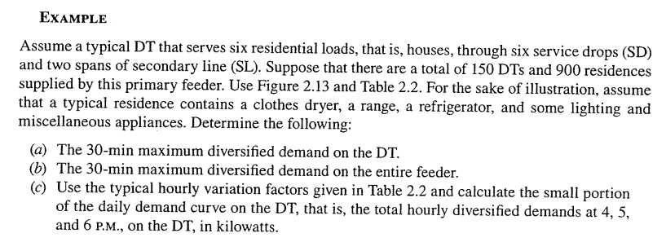

Slide 8
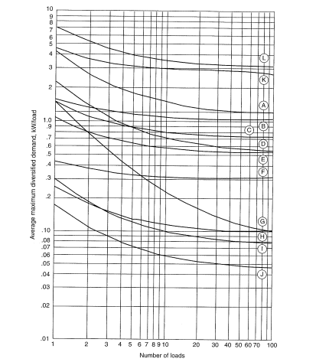

Slide 9
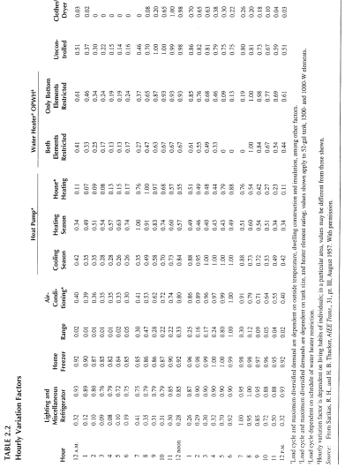

Slide 10
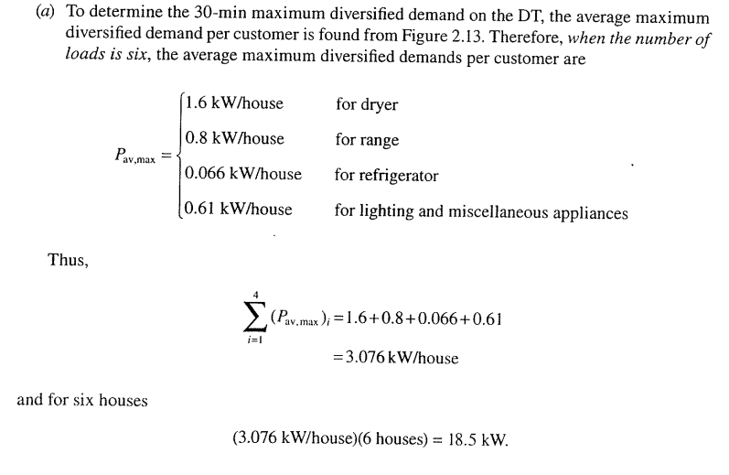
Solution

Slide 11
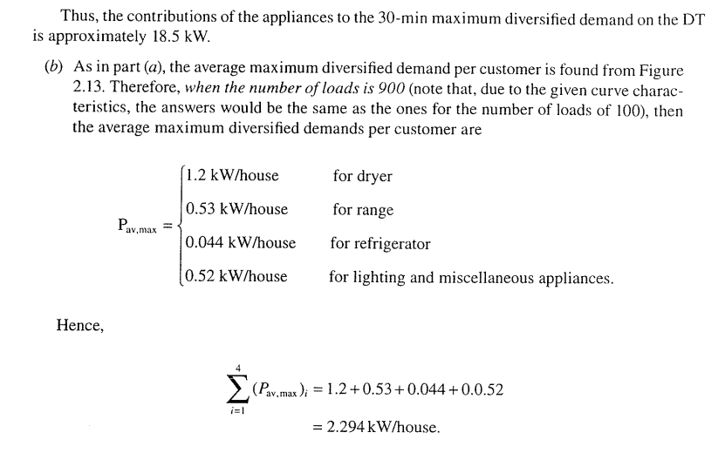

Slide 12
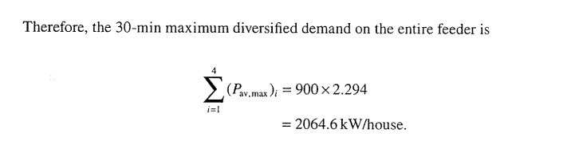

Slide 13
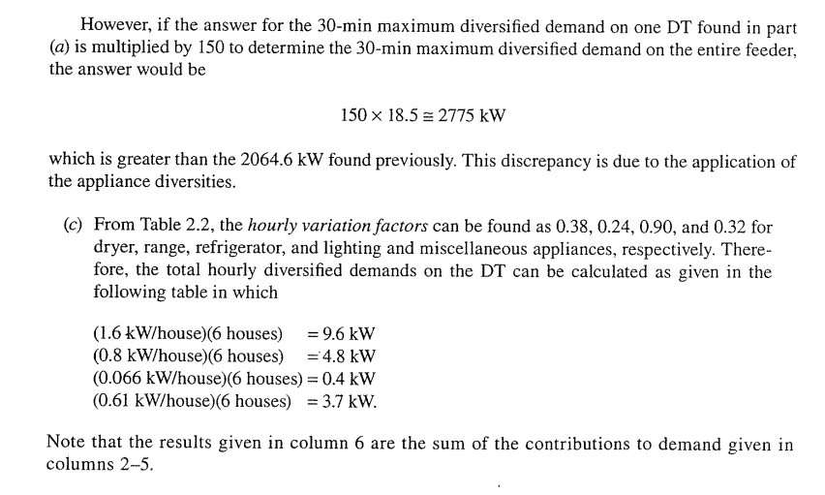

Slide 14
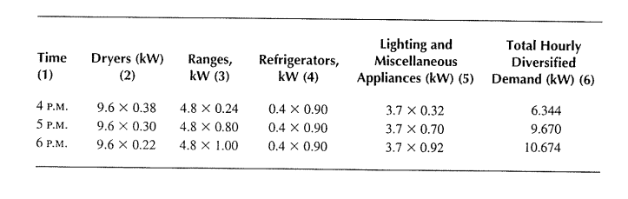

Slide 15
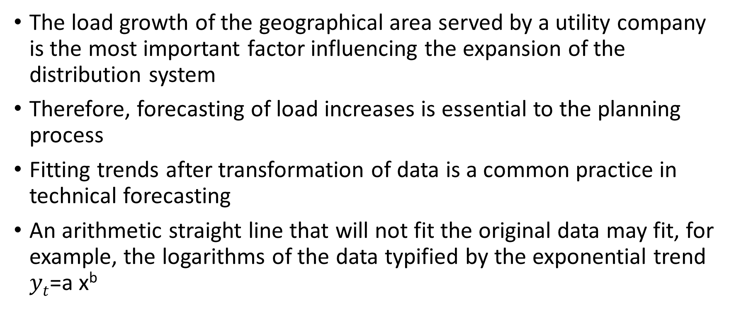
Load Forecasting (1)
The load growth of the geographical area served by a utility company is the most important factor influencing the expansion of the distribution system
Therefore, forecasting of load increases is essential to the planning process
Fitting trends after transformation of data is a common practice in technical forecasting
An arithmetic straight line that will not fit the original data may fit, for example, the logarithms of the data typified by the exponential trend $yt$=a x^{b}

Slide 16
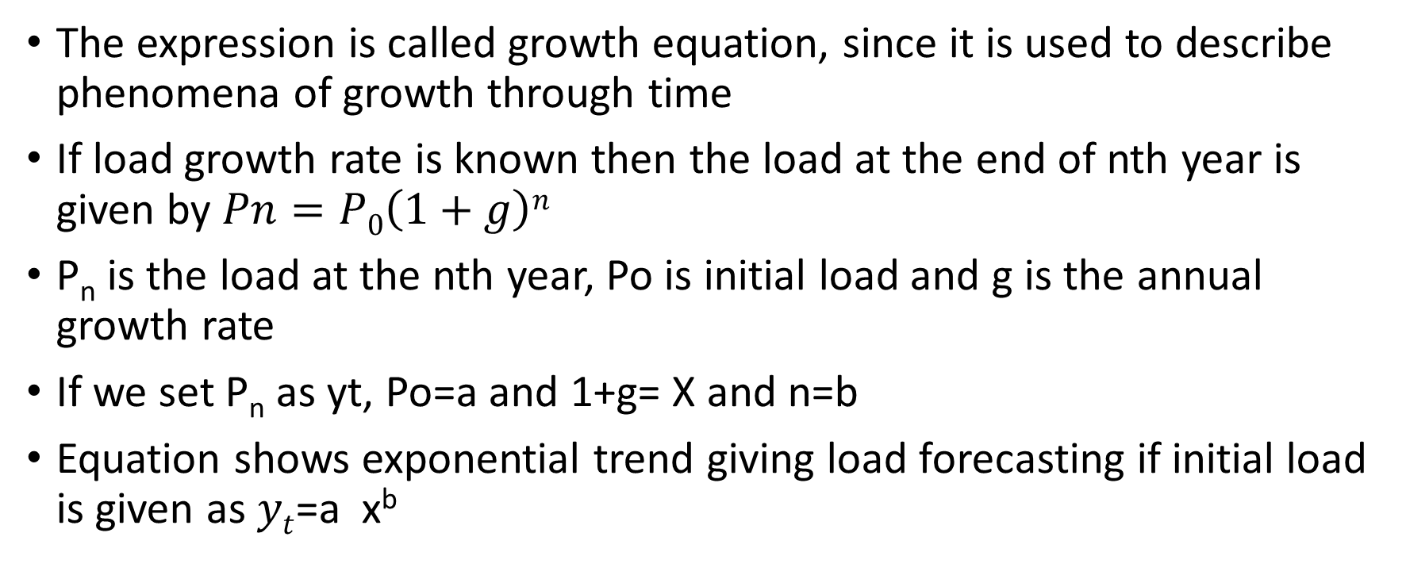
The expression is called growth equation, since it is used to describe phenomena of growth through time
If load growth rate is known then the load at the end of nth year is given by $Pn=P0\left(1+g\right)n$
P_{n} is the load at the nth year, Po is initial load and g is the annual growth rate
If we set P_{n} as yt, Po=a and 1+g= X and n=b
Equation shows exponential trend giving load forecasting if initial load is given as $yt$=a x^{b}

Slide 17
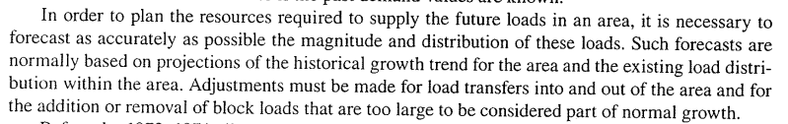
Forecast by Historical Trends (2)

Slide 18
Forecast by location (3)
Methods that forecast future demand by location divide the utility service area into set of small areas forecasting the load growth in each
Most modern small area forecast method work with uniform grid of small areas cover the utility service area
Regardless of how small areas are defined, most forecasting methods themselves invariably fall into two categories, trending and land use
Trending extrapolate past historical peak loads using curve fitting or some other method

Slide 19
On the contrary, the behavior of land growth in any relatively small area is not smooth curve but “S” curve which includes distinct phases like dormant, growth and saturation phases
In order to plan a T&D system, it is necessary to study not just overall load in a region but to study and forecast load on SPATIAL BASIS, i.e., analyzing it in a total and on a local area basis throughout the system determining “where” and “How much” load growth is expected for determining transmission and distribution expansion
Regression is the study of the behavior of a time series or a process in the past and its mathematical modeling so that future behavior is extrapolated

Slide 20
Fitting of continuous mathematical functions through actual data to achieve the least overall error is known as regression analysis
The second approach is more widespread in short term forecasting
A time varying event such as distribution system load can be broken down into following four major components;
1- Basic trend
2- Seasonal variation that is monthly and yearly
3- Cyclic variation which includes influences of periods longer than above and causes the load pattern to be repeated for 2-3 years or even longer

Slide 21
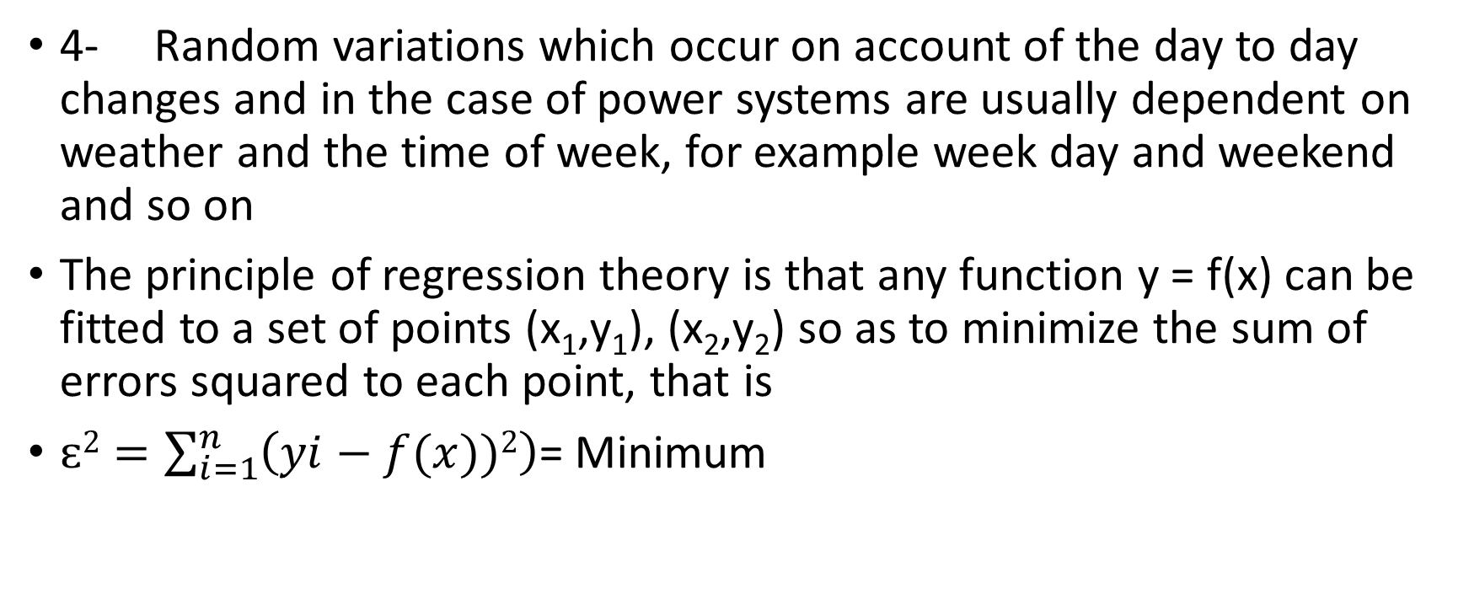
4- Random variations which occur on account of the day to day changes and in the case of power systems are usually dependent on weather and the time of week, for example week day and weekend and so on
The principle of regression theory is that any function y = f(x) can be fitted to a set of points (x₁,y₁), (x₂,y₂) so as to minimize the sum of errors squared to each point, that is
$ɛ2=\sum_{i=1}^{n}{\left(yi−f(x))2\right)}$= Minimum

Slide 22
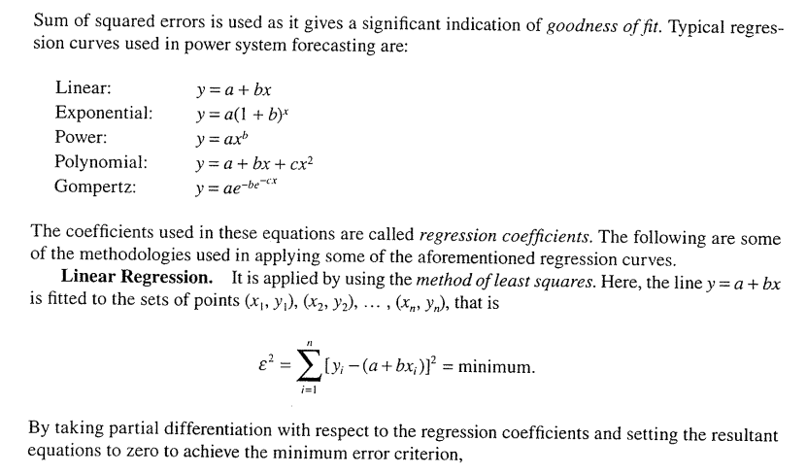

Slide 23
Other techniques are Least square Parabola, least square exponential, Multiple regression

Slide 24
BOX-JENKINS METHOD
This method uses a stochastic time series to forecast future load demands
It is popular method for short term forecasting
Box and Jenkins developed a method of forecasting by trying to account for repeated movements in the historical series, leaving a series made up of only random that is irregular movement
To model the systematic patterns inherent in this series and upon differencing to account for seasonal and earthly movements

Slide 25
The Box Jenkins methodology is an iterative procedure by which a stochastic model is constructed
The process starts with the most simple structure with least number of parameters and develops into as complex structure as necessary to obtain an adequate model

Slide 26
Small Area load forecasting
In this forecasting, the utility services area is divided into a set of small areas and the future load growth in each area is forecasted
Most modern area forecast methods work with a uniform grid of small area that covers the utility service area , but more traditional approach was to forecast growth on a substation by substation or feeder by feeder basis
A small area is not smooth which is intense for several years then drops to very low level while high growth begins in other areas which is in Gompertz or “S” curve

Slide 27
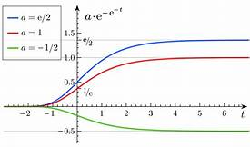
Gompertz Curve

Slide 28
It is a type of mathematical model for a time series, where growth is slowest at the start and end of a time period.
Examples of uses for Gompertz curves include:
Mobile phone uptake, where costs were initially high (so uptake was slow), followed by a period of rapid growth, followed by a slowing of uptake as saturation was reached
Population growth in a confined space first increase and then slow as resource limits are reached.
Modeling of growth of tumors

Slide 29
Spatial Load Forecasting
In general small area load growth is spatial.
The majority of load growth effects in any small area are due to effects from other small areas, some are far away and a function of distances from those areas
Therefore, the forecast of any one area must be based on an assessment data not only for that area but also for neighboring areas
The best available trending method in terms of tested accuracy is load trend coupled (LTC) extrapolation using modified form of Markov regression in which computation for load extrapolation has been considerably reduced

Slide 30
Load Management
Load management process involves controlling system loads by remote control of individual customer loads
Such control includes suppressing or biasing automatic control of cycling loads as well as load switching
Load management can also be affected by inducing customers to suppress loads during utility selected daily periods by means of time of day rate incentives
Such activities are called demand side management (DSM)
Demand side management includes all measures, programs, equipment and activities that are directed towards improving efficiency and cost effectiveness of energy usage on the customer side

Slide 31
In general, such load control results in a load reduction at time “t” that is ΔS(t) which can be expressed as;
ΔS(t)= S_{avg} X [D_{uncont} (t) – D_{cont} (t)] X N
Where S_{avg} is the average connected load of controlled devices, D_{uncont}(t) is the duty cycle allowed by the load control at time t, and N is number of units under control
Distribution automation provides the control and monitoring ability required for both load management scenarios
It provides for direct control of customer loads, and the monitoring necessary to verify that programmed levels are achieved

Slide 32
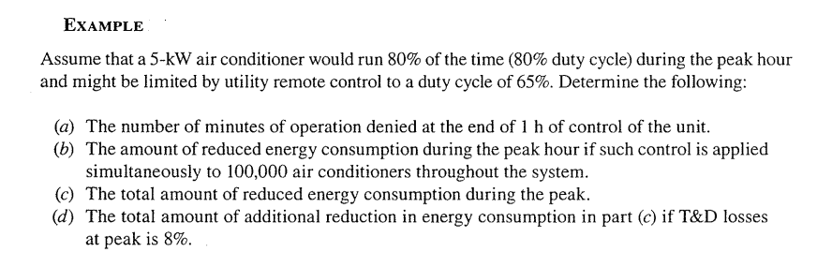

Slide 33
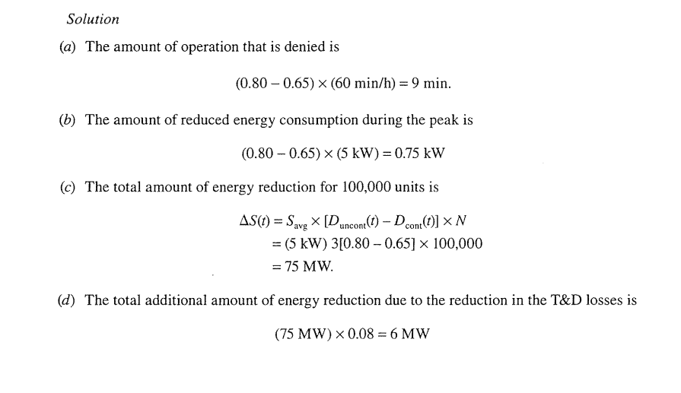

Slide 34
Thus overall total reduction is;
75 MW +6 MW= 81 MW

Slide 35
Fuel cost Adjustment
Calculated monthly bill rate may be increased or decreased for each KWh consumed by an amount calculated as per given formula;
FCAF= A X B X 10⁻⁶ X C X (1/1-D)
FCAF is fuel cost adjustment factor, $/KWh, to be applied on each KWh consumed
A- weighted average BTU per KWh for net generation from thermal plants
B- Amount by which average cost of fuel per million BTU is billed
C- Ratio in decimal , of total net generation from thermal plants to total net generation from all plants including hydrogenation
D- Loss factor, ratio of KW-Hour losses to net system input

Slide 36
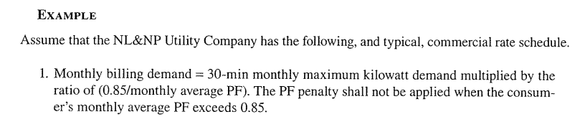

Slide 37
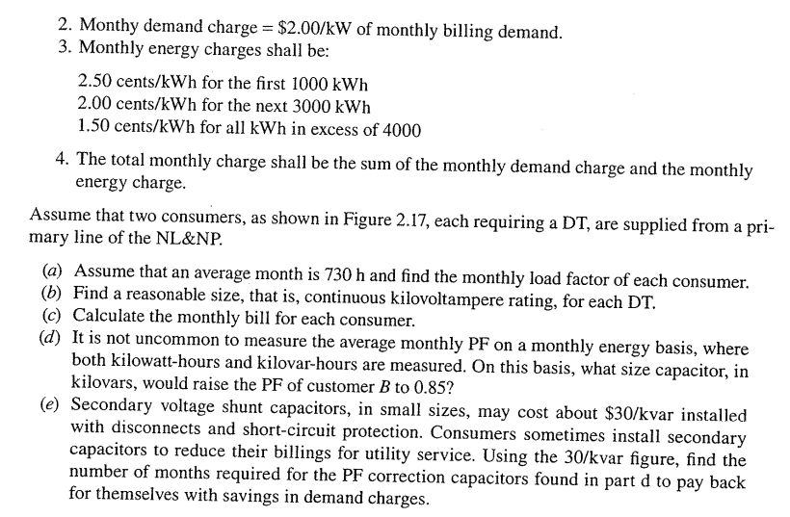

Slide 38
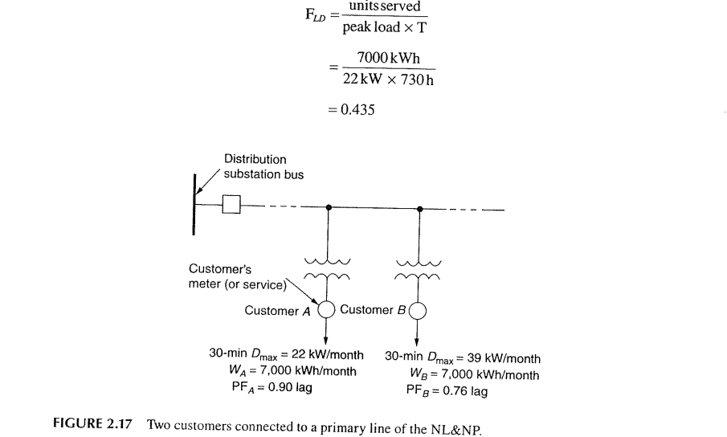
Solution

Slide 39
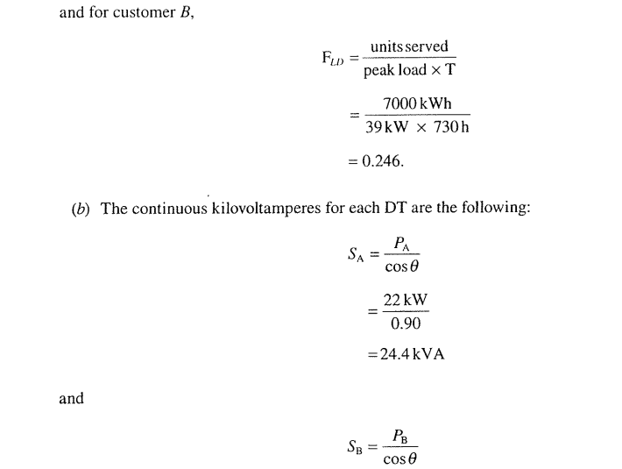

Slide 40
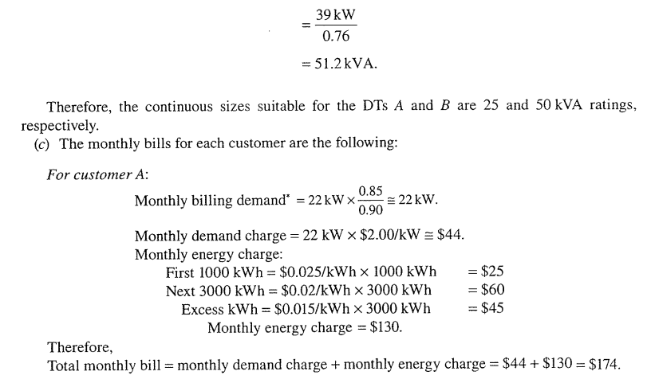

Slide 41
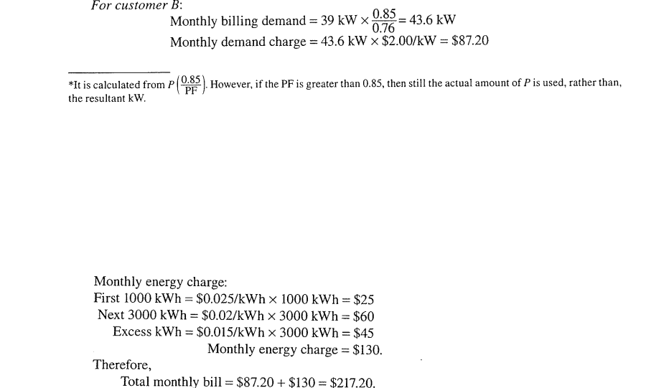

Slide 42
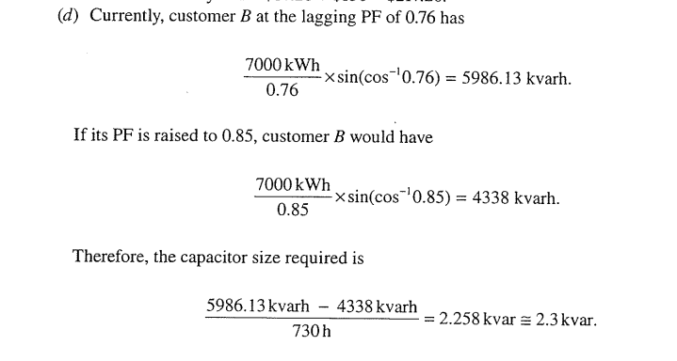

Slide 43
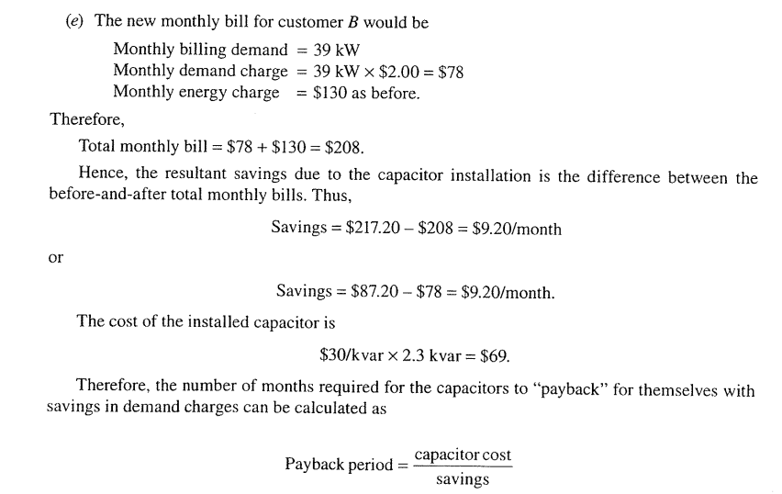

Slide 44
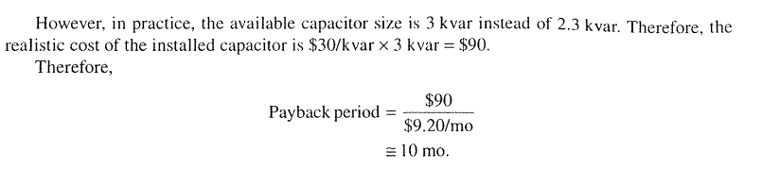
Pay Back period will be 8 months…$69/$9.2/Month
Discussion will be continued

